Slide 1

Newton’s Rings & Interferometer
MD. GULAM MUSTAFA
Lecturer (Physics)
Department of Science & Humanities
Bangladesh Army International University of Science and Technology (BAIUST)
Syedpur, Cumilla-3501

Slide 2

Whatever we will discuss
Explanation of the formation of Newton’s Rings
Determination of the wavelength of sodium light with the help of Newton’s Rings
Construction and working of Michelson Interferometer
Newton’s rings experiment related mathematical problems

Slide 3
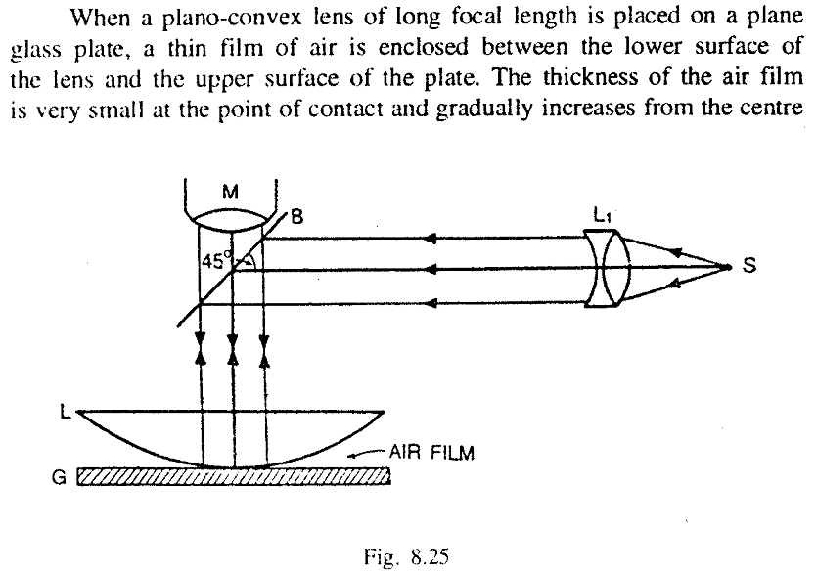
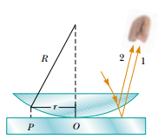
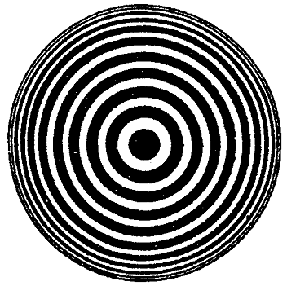
Formation of Newton’s Rings

Slide 4
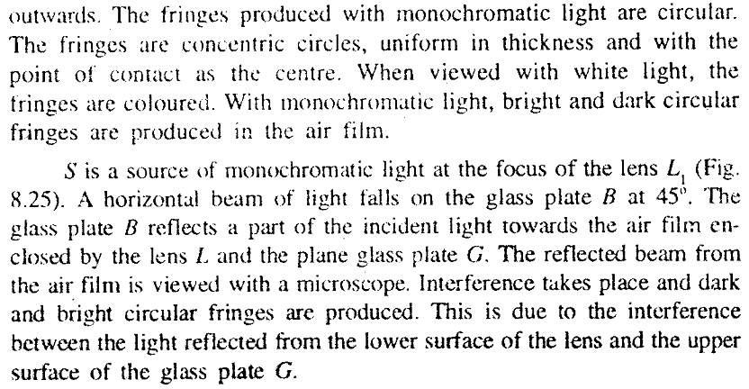
Formation of Newton’s Rings

Slide 5
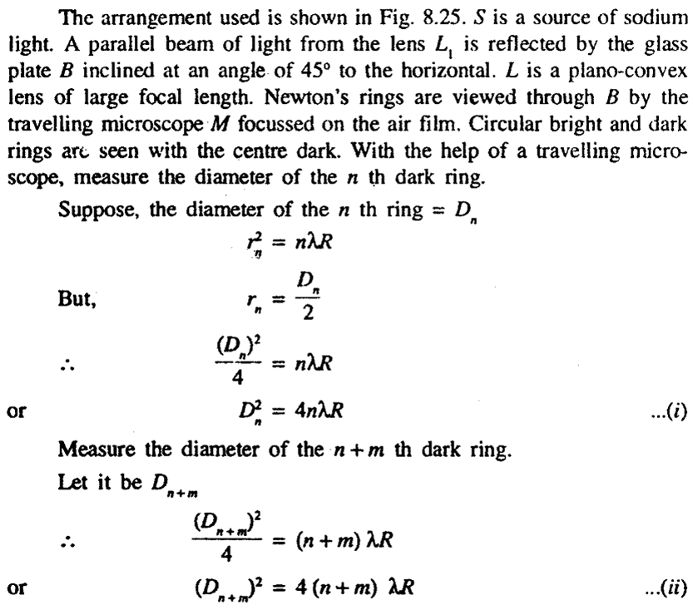
Determination of wavelength

Slide 6
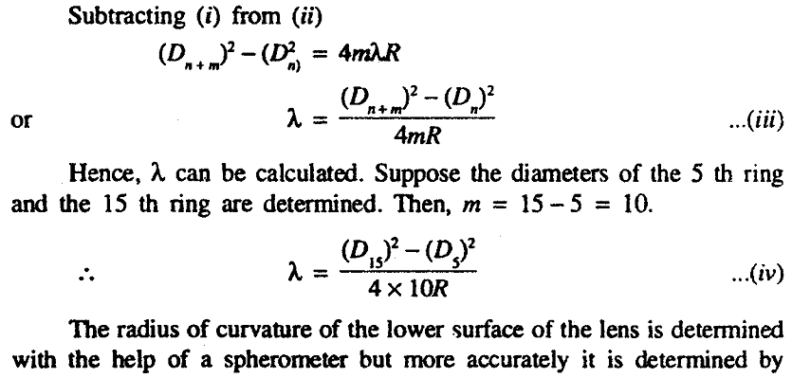

Slide 7
INTERFEROMETER
An interferometer is an optical device in which the phenomenon of interference is used to make precise measurements of wavelengths or distances.
Types of Interferometers
Michelson Interferometer
Mach- Zehnder Interferometer
Fabry- Perot Interferometer
Sagnac Interferometer
Common Path Interferometer
Pitter- NPL Interferometer

Slide 8
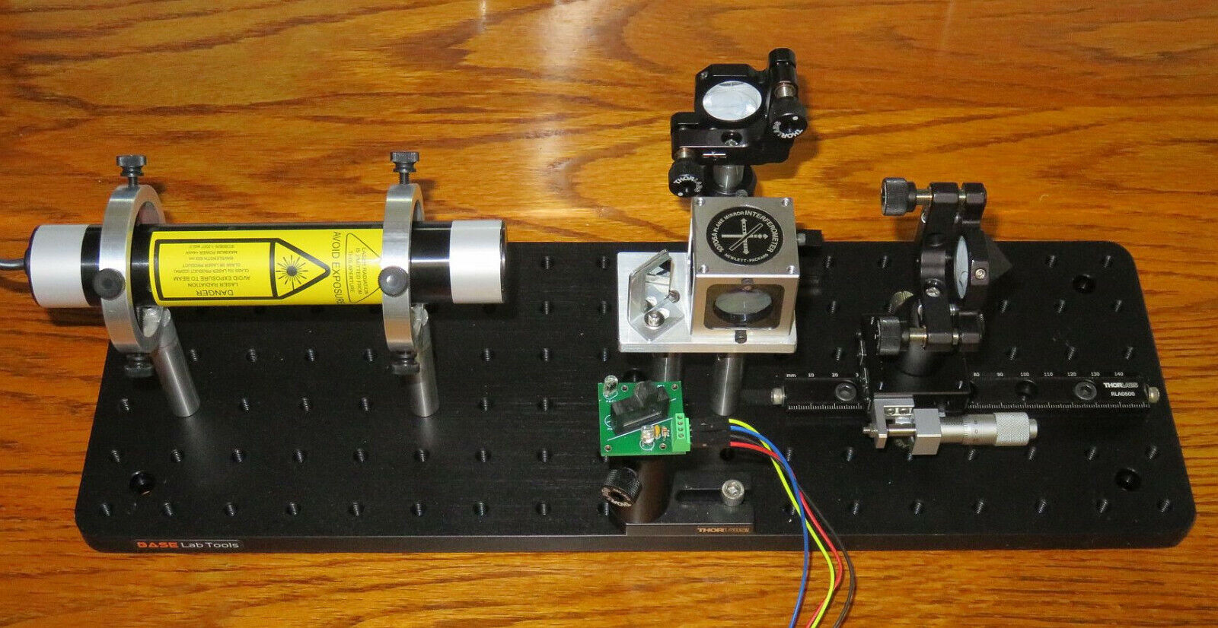
MICHELSON INTERFEROMETER
Fig: Michelson Interferometer Experimental Setup.

Slide 9
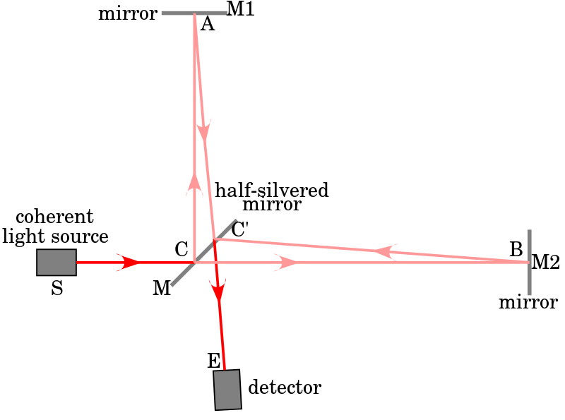
Fig: Working Principle of Michelson Interferometer
A beam of light from an coherent source is divided into two parts of equal intensities by partial reflection and refraction.
These beams travel in two mutually perpendicular directions and come together after reflection from plane mirrors.
The beams overlap on each other and produce interference fringes.

Slide 10
Applications of Michelson Interferometer
Measurement of Wavelength.
Determination of the thickness of a Thin Transparent Sheet.
Determination of the difference in the Wavelength of two Waves.
Determination of the Refractive Index of Gases.
Standardization of the Meter.

Slide 11
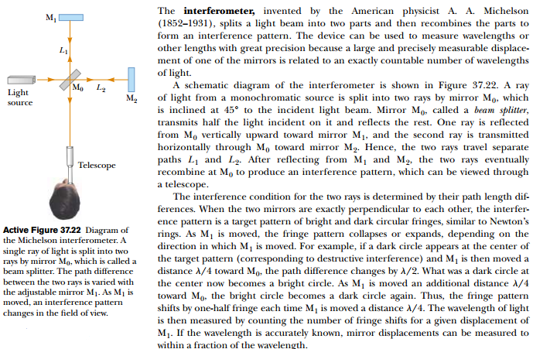
Michelson Interferometer

Slide 12
Related Mathematical Problems
  Example: 8.48, 8.49, & 8.54
  A Text Book of Optics by Subrahmanyam and Brijlal (pp. 333-337)

Slide 13


